Slide 1
CVLab unseen spacescraft pose estimation
Papers review
EPFL
28th September 2023

Slide 2
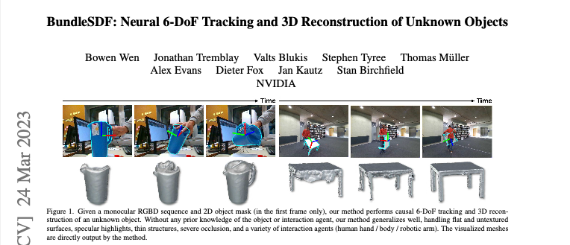
EPFL
28th September 2023

Slide 3
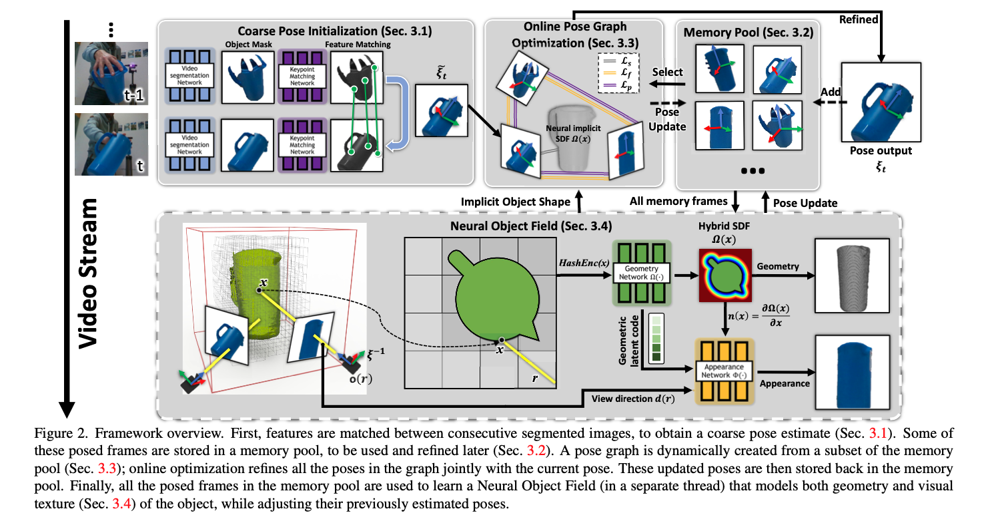
EPFL
28th September 2023

Slide 4
Need:
- Monocular RGBD video sequence needed
- Requires a segmentation mask of the object of interest in the first frame only
No need to train on the same object category beforehand
- Tracks the 6-DoF pose of the object through subsequent frames
- Reconstructs a textured 3D model of the unseen object
Architecture relies on graph optimization
EPFL
28th September 2023

Slide 5
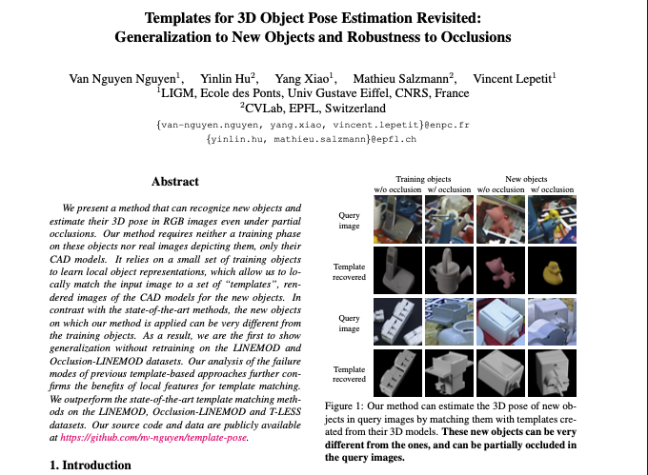
EPFL
28th September 2023

Slide 6
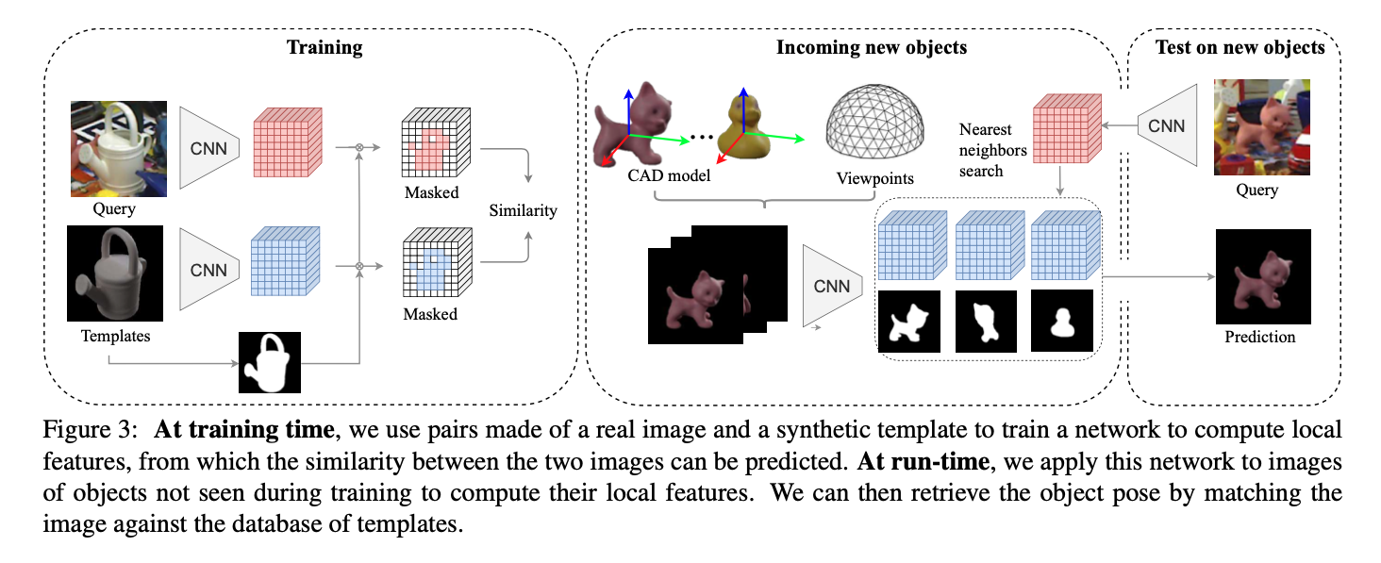
EPFL
28th September 2023

Slide 7
Need:
- CAD-generated 3D models (template-based approach)
- Real images for training
- Can recognize new objects
- Estimate 3D pose in RGB images
Architecture relies on constrative learning (learn an embedding space where similar images are close to each other)
EPFL
28th September 2023

Slide 8
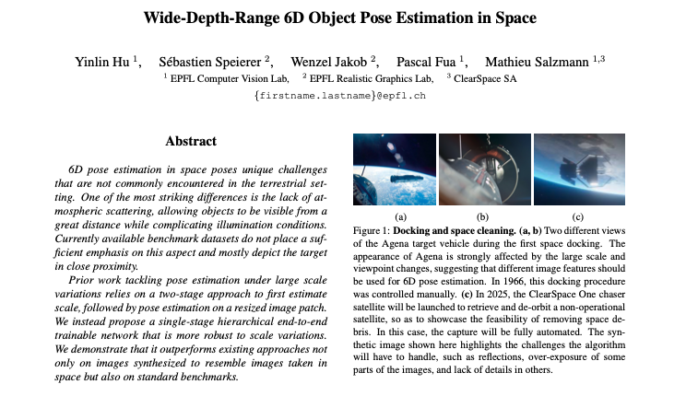
EPFL
28th September 2023

Slide 9
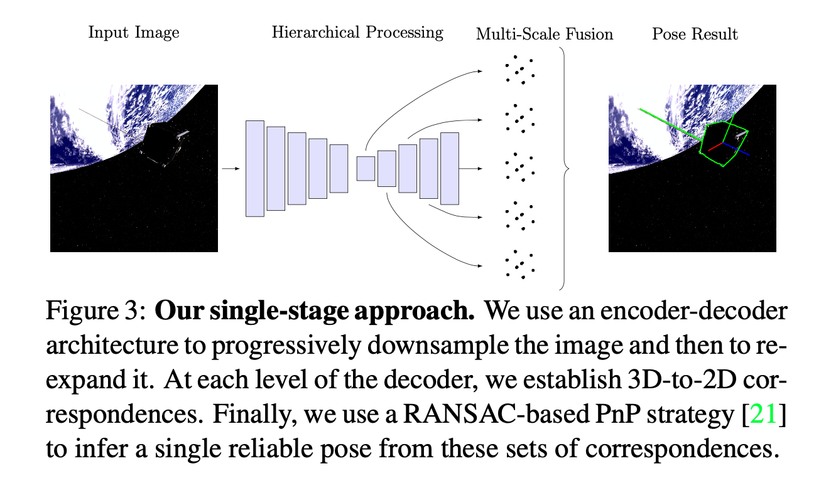
EPFL
28th September 2023

Slide 10
Relevant since space context means scale variations, complicated light conditions, no atmospheric scattering
Need:
- Small amounts of annotated real data
Counterpart:
- Objects must be known
The deep network regresses the 2D projections to predifined 3D points.
Architecture relies on Feature Pyramid Network (FPN), performs the regression at multiple scales, and fuse the resulting multiple estimate in a robust pose prediction.
EPFL
28th September 2023

Slide 11
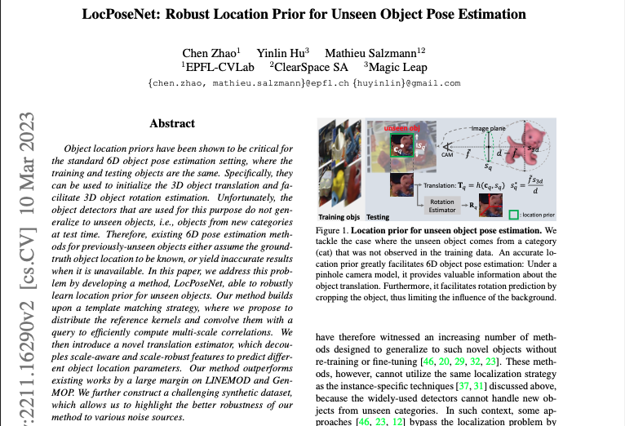
EPFL
28th September 2023

Slide 12
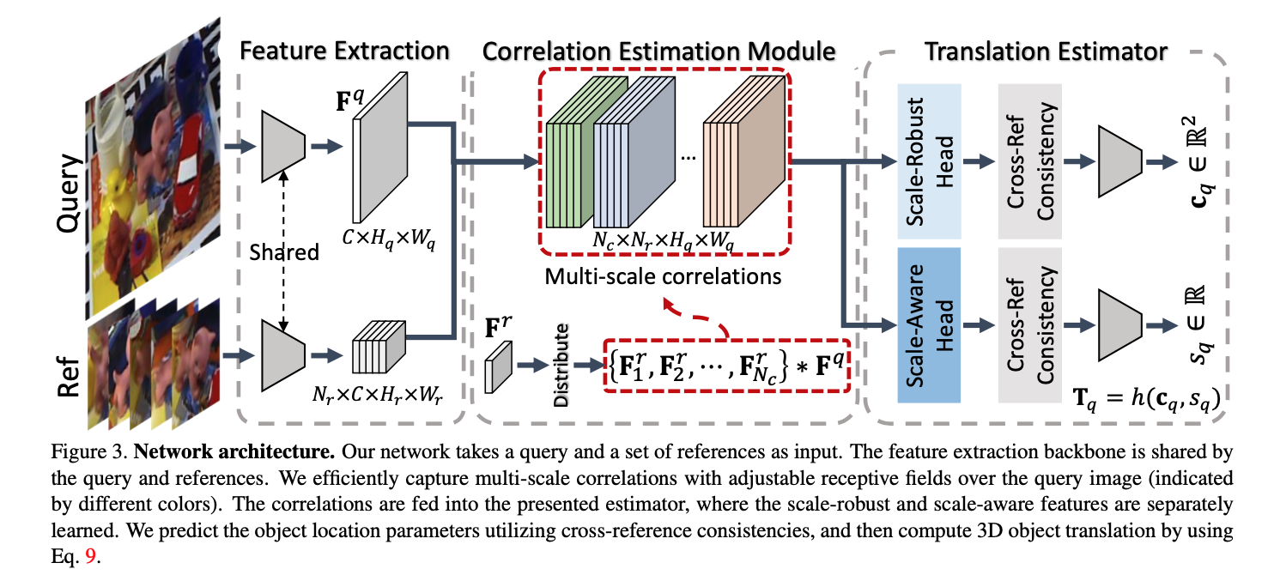
EPFL
28th September 2023

